Slide 1

TravelAmaze
A Bot will be your guide
Presented By:
Sk. Hafiza(225202)
K. Krishna Bhavani(225232)

Slide 2



Introduction to TravelAmaze
TravelAmaze is an innovative tourism chatbot that leverages the power of the Wikimedia API and the Rasa framework to provide users with a seamless and informative travel experience.

Slide 3
Leveraging Wikimedia API and Rasa Framework
Wikimedia API
Rasa Framework
Synergy
TravelAmaze taps into the vast repository of travel-related information available in the Wikimedia API, ensuring users have access to accurate and up-to-date details.
The Rasa framework powers the chatbot's natural language processing capabilities, enabling seamless and intuitive conversations with users.
By combining these powerful technologies, TravelAmaze delivers a comprehensive and user-friendly travel planning experience.

Slide 4

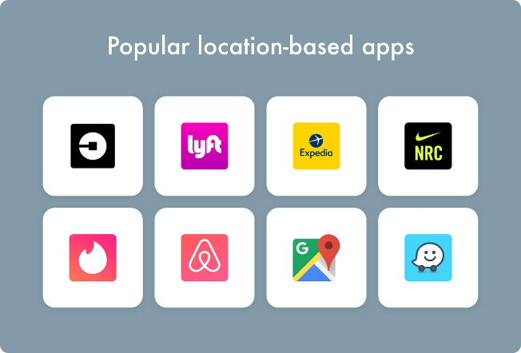
Providing Location-based Information
1
Detailed Destination Profiles
TravelAmaze provides detailed information about a user's chosen destination, including historical landmarks, cultural attractions, and local cuisine.
2
Customized Recommendations
The chatbot analyzes the user's preferences and interests to suggest personalized itineraries and activities.
3
Real-time Updates
TravelAmaze keeps users informed about any changes or updates to their travel plans, ensuring a seamless experience.

Slide 5




Nearby Cafes, Restaurants, and Hotels
Cafes
Restaurants
Hotels
TravelAmaze helps users discover the best local cafes, complete with reviews and recommendations.
The chatbot offers insights into the top-rated restaurants in the area, catering to a variety of cuisines and dietary preferences.
TravelAmaze provides users with options for comfortable and convenient accommodation, tailored to their budget and needs.

Slide 6




Enhancing the Travel Experience
Personalization
Seamless Integration
Offline Accessibility
TravelAmaze learns from user preferences to offer customized recommendations, ensuring a truly personalized travel experience.
The chatbot seamlessly integrates with other travel-related services, such as booking platforms and transportation providers, for a comprehensive solution.
TravelAmaze's offline functionality allows users to access essential information and plan their trips even in areas with limited internet connectivity.

Slide 7

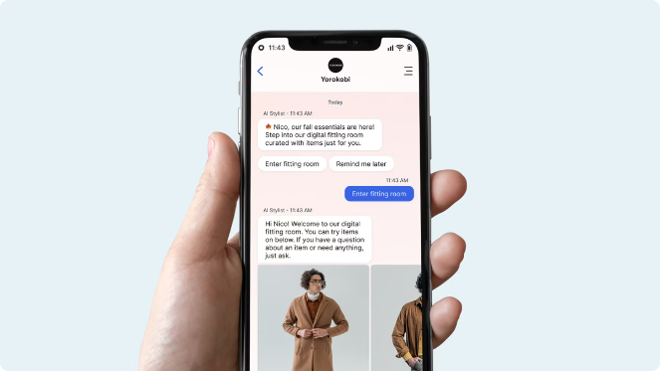
User-friendly Conversational Interface
Natural Language Processing
TravelAmaze's advanced natural language processing capabilities enable users to engage in intuitive, human-like conversations.
Multilingual Support
The chatbot supports multiple languages, catering to a diverse user base and ensuring global accessibility.
Contextual Understanding
TravelAmaze demonstrates a deep understanding of the user's context, providing relevant and tailored responses.
Continuous Learning
The chatbot continuously learns from user interactions, improving its abilities to provide even better assistance over time.

Slide 8

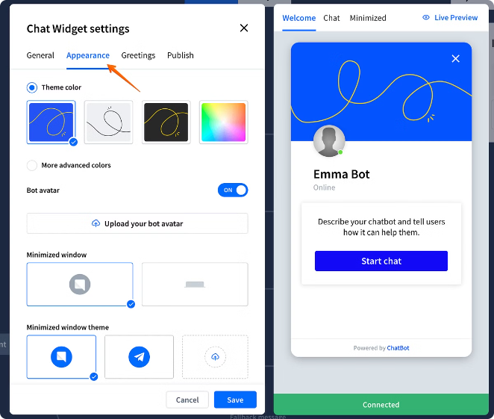
Scalable and Customizable Chatbot Solution
1
Modular Architecture
TravelAmaze's modular architecture allows for seamless integration with existing systems and easy customization to meet client-specific requirements.
2
Scalable Infrastructure
The chatbot's scalable infrastructure ensures that it can handle high user volumes and provide a consistently reliable experience.
3
Continuous Improvement
TravelAmaze undergoes regular updates and enhancements, ensuring it stays at the forefront of the latest technological advancements.

Slide 9


Conclusion and Future Enhancements
1
Empowering Travelers
TravelAmaze empowers travelers with a comprehensive, user-friendly platform that simplifies the planning and execution of their trips.
2
Continuous Innovation
The chatbot's development team is committed to exploring new technologies and features to further enhance the travel experience.
3
Expanding Horizons
As TravelAmaze continues to evolve, it aims to become the go-to travel companion for users worldwide, revolutionizing the tourism industry.

Slide 10
Thank You

